Slide 1
SCDOT Highway Safety Program
D. Brett Harrelson, PE
State Safety Engineer

Slide 2
Traffic Fatalities in SC
Notes:
56% of all 2013 fatalities were not wearing seatbelts
Nearly 50% of all fatalities involve vehicles leaving roadway
40% of all fatal crashes on interstate involve a vehicle striking a tree
41% of all fatal crashes were alcohol related
37% of fatal crashes were speed related

Slide 3
Fatality Rate
National Safety Rankings (2015)
South Carolina
Total Fatality Rate – 1st (1.65)
53% above national rate (39% above SE rate)
NC – 1.19
GA – 1.04
Fatalities needed to reduce to meet national rate = 398
Urban Fatality Rate – 1st (1.55)
90% above national rate
58% above SE rate
Road Departure Fatality Rate – 3rd (MT, WY)
22% above national rate
TN – 1.33
FL – 1.24
MS – 1.59
Notes:
State the Problem
How Do We Compare to the Nation
How do we compare to neighboring/similar states

Slide 4
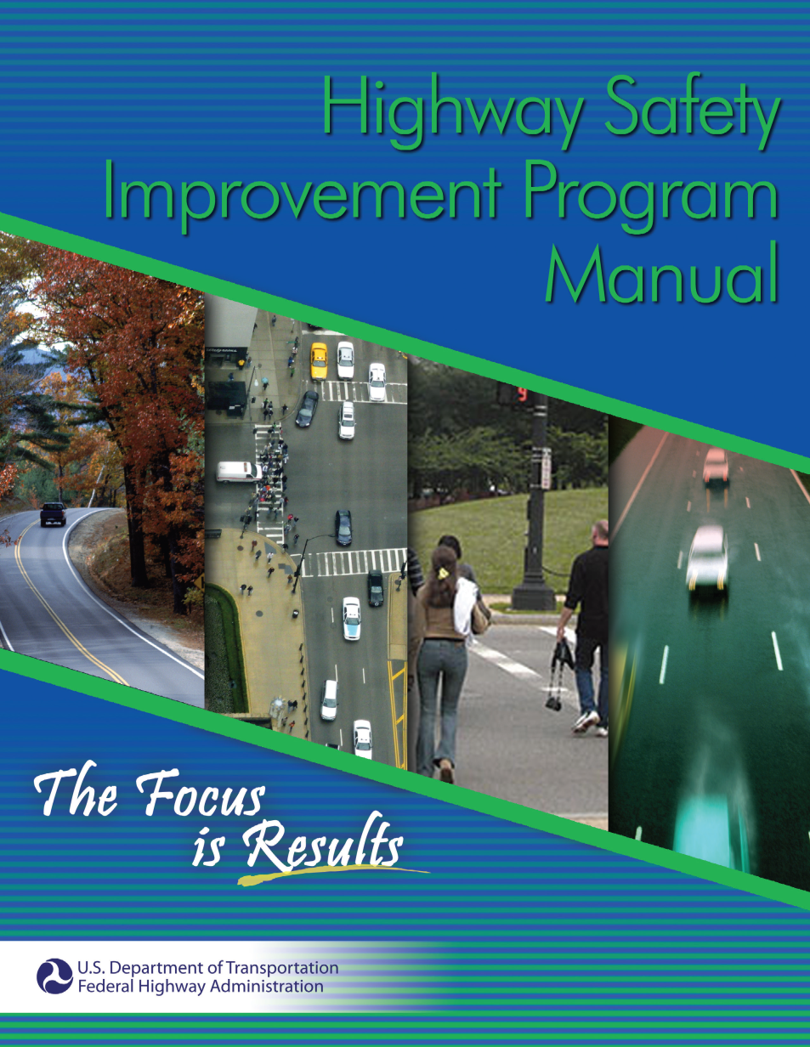
Highway Safety Improvement Program (HSIP)
To achieve a significant reduction in traffic fatalities and serious injuries on public roads

Slide 5
HSIP 4-step Process
Data Analysis
Comprehensive Engineering Study and Field Review
Project Evaluation
Project Selection

Slide 6
HSIP - Program Evaluation
SCDOT Safety Program Effectiveness
Projects Evaluated (2011 – 2015) | 102
Total Crash Reduction | 37%
Fatal Crash Reduction | 85%
Injury Crash Reduction | 37%
PDO Crash Reduction | 36%
Average B/C Ratio | 26.09

Slide 7
GPATS Safety Data Overview

Slide 8
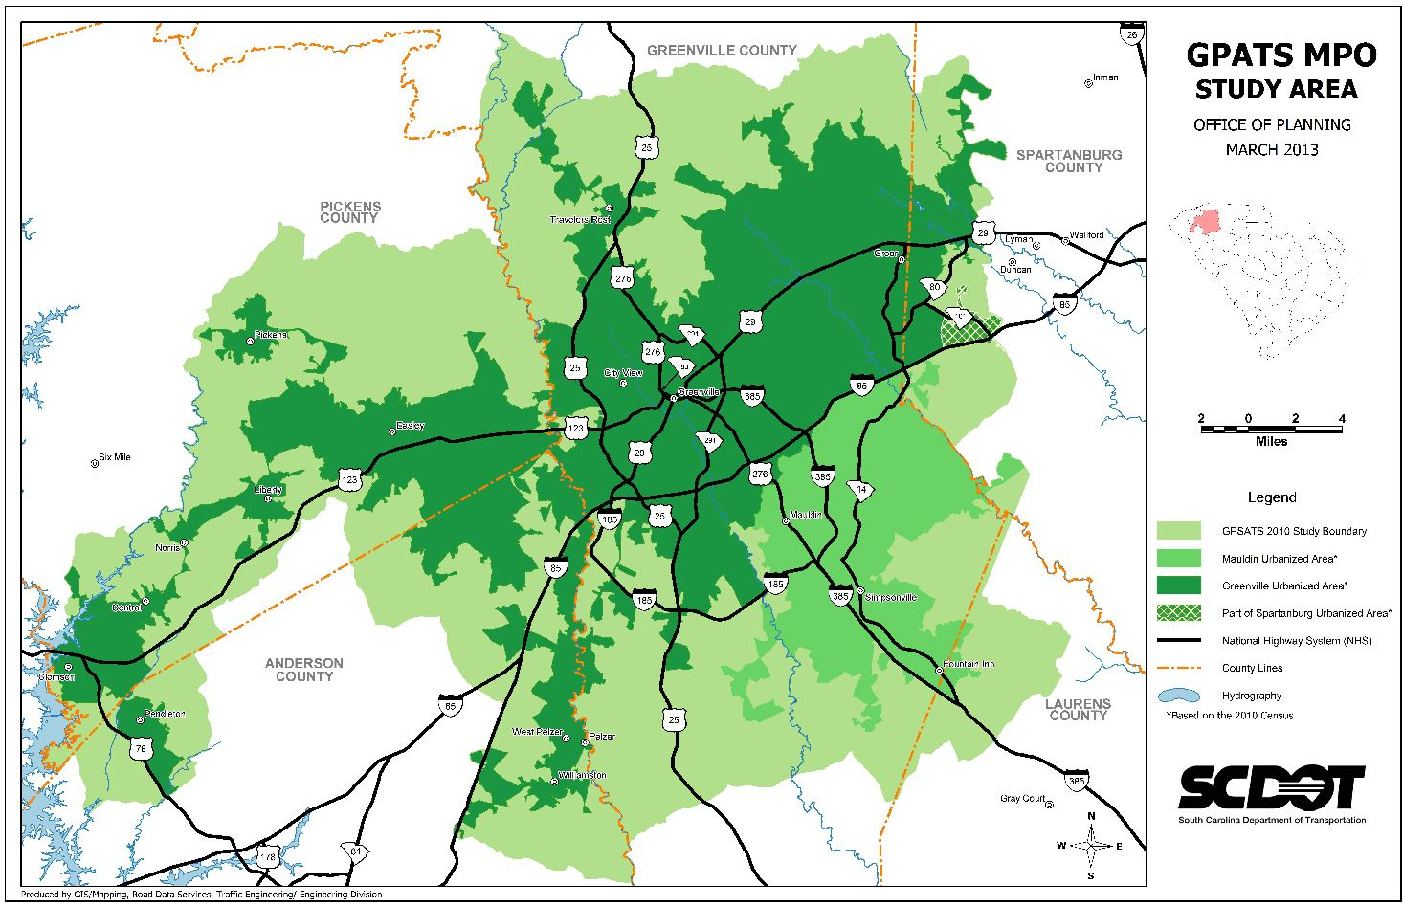
GPATS Study Area

Slide 9
SHSP Emphasis Areas (most common factors)
Crash Dates: 2011 - 2015

Slide 10
SHSP Emphasis Areas (most common factors)
Crash Dates: 2011 - 2015

Slide 11
SHSP Emphasis Areas (Engineering Areas)
Total Number of Fatal & SI Crashes: 1687
Crash Dates: 2011 - 2015

Slide 12
GPATS Fatal & SI Analysis
2% of Mileage
56% of Mileage
31% of Mileage
11% of Mileage
Total Number of Fatal & SI Crashes: 1679
Total Mileage: 4429 Miles
Crash Date Range: 2011-2015

Slide 13
GPATS Fatal & SI Analysis
26% of Mileage
74% of Mileage
MPOs Statewide: 22% Rural, 78% Urban
Total Number of Fatal & SI Crashes: 1679
Crash Date Range: 2011-2015

Slide 14
Eng. Related Priority Areas
*Each crash was assigned to one category in a hierarchical method starting with Road Departure going clockwise. (I.E. intersections contain pedestrian crashes at an intersection)
Total Number of Fatal & SI Crashes: 1679
Crash Date Range: 2011-2015
Notes:
Unique numbers, FLIP VRU-> Int -> RD CHECK MOTORCYCLE TO STATE MPO

Slide 15
Road Departure Analysis

Slide 16
Road Departure
“It is the height of cynicism to contend that the drivers should never have left the roadway or that many of them must have been drunk, or that somehow the driver was at fault. Why or how he left the road is not the issue.
Whether he left because he was drunk, or stealing a kiss, or because he suffered a bee sting, dozed, had a blowout, was sideswiped, or forced off the road is irrelevant to roadbuilders.”

Slide 17
Road Departure
“What is relevant is that those who are responsible for road construction recognize that the roadside is as vital to the safe operation of a vehicle as the pavement itself, and that the duty to make that roadside safe is a very real one”
Rep. John Blatnik (D-MN)

Slide 18
Road Departure Analysis
Total Number of Fatal & SI Crashes: 695
Crash Date Range: 2011-2015

Slide 19
RD Fixed Object Analysis
Other Includes:
Guardrail
Culverts
Fence
Signs
Bridge Structures
Total Number of Fatal & SI Crashes: 527
Crash Date Range: 2011-2015
Notes:
Used Tree involved column

Slide 20
Road Departure Analysis
2% of Mileage
56% of Mileage
11% of Mileage
31% of Mileage
Total Number of Fatal & SI Crashes: 695
Crash Date Range: 2011-2015

Slide 21
Road Departure Analysis
RD by AADT | GPATS
 | F&SI Crashes | % of F&SI Crashes | Miles | % of Mileage
<1,000 | 186 | 27% | 2912.1 | 66%
1,000 to 4,999 | 200 | 29% | 806.3 | 18%
5,000 to 9,999 | 114 | 16% | 332.2 | 7%
>10,000 | 195 | 28% | 378.8 | 9%
Totals | 695 | 100% | 4429.4 | 100%
Total Number of Fatal & SI Crashes: 695
Crash Date Range: 2011-2015
Notes:
Check 28% subset again recreate slide 21:
49 interstate
106 primary (71 US) 17 tree 15 curb 12 miscoded nothing really stands out look again into the
38 secondary

Slide 22
Road Departure Analysis
Total Number of Fatal & SI Crashes: 309
Crash Date Range: 2011-2015
Notes:
Check 28% subset again recreate slide 21:
49 interstate
106 primary (71 US) 17 tree 15 curb 12 miscoded nothing really stands out look again into the
38 secondary

Slide 23
Road Departure Analysis
Other Includes:
Guardrail
Mailboxes
Culverts
Fence
Signs
Bridge Structures
Total Number of Fatal & SI Crashes: 309
Crash Date Range: 2011-2015
Notes:
Check 28% subset again recreate slide 21:
49 interstate
106 primary (71 US) 17 tree 15 curb 12 miscoded nothing really stands out look again into the
38 secondary

Slide 24
Road Departure Corridor Analysis
County | Route | Fatal & SI Crashes | % of Fatal & SI Crashes | Miles | % of Mileage
Greenville/Anderson/ Spartanburg | I-85 | 30 | 4.3% | 28.1 | 0.6%
Greenville | US 25 | 24 | 3.5% | 35.0 | 0.8%
Pickens/Greenville | US 123 | 22 | 3.2% | 30.49 | 0.7%
Greenville | I-385 | 19 | 2.7% | 19.54 | 0.5%
Greenville/Anderson/ Spartanburg | US 29 | 18 | 2.6% | 30.06 | 0.7%
Greenville | US 276 | 16 | 2.3% | 29.335 | 0.7%
Total Number of Fatal & SI Crashes: 695
18.6%
4%
Total Mileage: 4429.4 Miles
Crash Date Range: 2011-2015
Notes:
Total columns
Greenville US 123 6.51 miles 6 crashes
Pickens US 123 23.98 miles 16 crashes
Anderson US 29 11.88 miles 7 crashes
Greenville US 29 15.24 miles 9 crashes
Spartanburg US 29 3.035 miles 2 crashes

Slide 25
Road Departure Countermeasures
Paved Shoulders
Rumble strips
Adequate Clear Zone
Cable guardrail
Enhanced Signing / Marking
Pavement Friction
Horizontal curve improvements
Account for 25% of all fatalities nationally
Notes:
Update

Slide 26
Intersection Analysis

Slide 27
Intersection Crash Analysis
Total Number of Fatal & SI Crashes: 347
Multiple Unit Crashes Only
Crash Date Range: 2011-2015
Notes:
Check # of lanes (all)
127 2-lane
173 4-lane
46 6/8 lane

Slide 28
Intersection Analysis
55% of crashes occurred at 9.6% of intersections
Total Number of Fatal & SI Crashes: 458
Crash Date Range: 2011-2015
Notes:
From TEAMS, 636 signals (in Greenville 544 & Pickens 92)
intersections total ~ 6,580 intersections
Unsignalized = 5944

Slide 29
Intersection Corridor Analysis
County | Route | Street Name | Intersection F&SI Crashes | % of Intersection F&SI Crashes | Length (miles) | % of Total Mileage
Greenville | US 25 | White Horse Road | 53 | 12% | 35.0 | 0.8%
Greenville/ Anderson/ Spartanburg | US 29 | Highway 29 /Wade Hampton Blvd/ Church St | 38 | 8% | 30.1 | 0.7%
Greenville | US 276 | Pointsett Hwy / Laurens Rd | 21 | 5% | 29.3 | 0.7%
Greenville/ Pickens | SC 183 | Farrs Bridge Rd | 18 | 4% | 22.3 | 0.5%
Greenville | SC 14 | 14 Highway | 17 | 4% | 31.2 | 0.7%
Greenville | SC 291 | Pleasantburg Drive | 17 | 4% | 11.4 | 0.3%
36%
3.6%
6 Corridors comprise 36% of all Intersection crashes
Total Number of Fatal & SI Crashes: 458
Crash Date Range: 2011-2015
Notes:
Target Zero
US 29: 30 Greenville (15.24 miles) 4 Anderson (11.8 miles)/Spartanburg (3.035 miles)
SC 183 11 Greenville (7.99 miles) 7 Pickens (14.3 miles)

Slide 30
Intersection / Corridor Countermeasures
Roundabouts
SCDOT Safety Office has completed 19 roundabouts
66% reduction in total crashes,
79% reduction in injury crashes
100% reduction in fatal crashes
Access Management
Alternative Intersection Designs
R-CUT, Superstreet
Adequate Sight Distance
Traffic Signals/Signs
Backplates with Retroreflective Borders
Road Diets
Notes:
Updated per conversation with Joey 10/24/2016. 19 Completed and 19 more planned

Slide 31
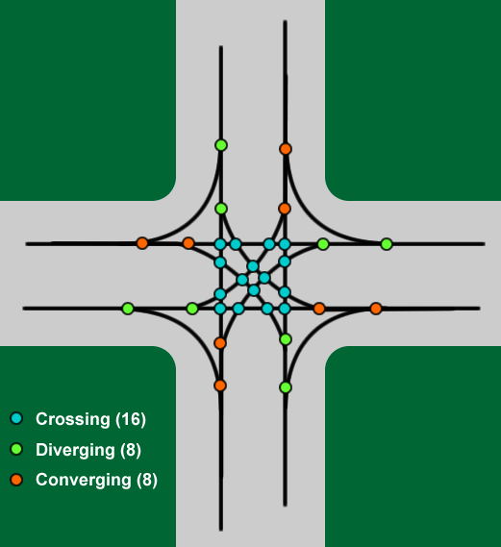
Roundabouts
Points of Conflict
Total = 8
Total = 32
Notes:
Not Edited

Slide 32
Public Attitude Toward Roundabouts

Slide 33
Superstreet Intersection
20% improvement in travel time
63% reduction in injury/fatal crashes
46% reduction in total crashes
Notes:
Not Edited

Slide 34
RCUT Intersection
2 Locations in SC
100% reduction in injury/fatal crashes
75% reduction in total crashes
Notes:
Not Edited

Slide 35
Access Management Analysis

Slide 36
Access Management Analysis
Total Number of Fatal & SI Crashes: 1679/314
Crash Date Range: 2011-2015
Notes:
Unique Values (each crash assigned to 1 category)

Slide 37
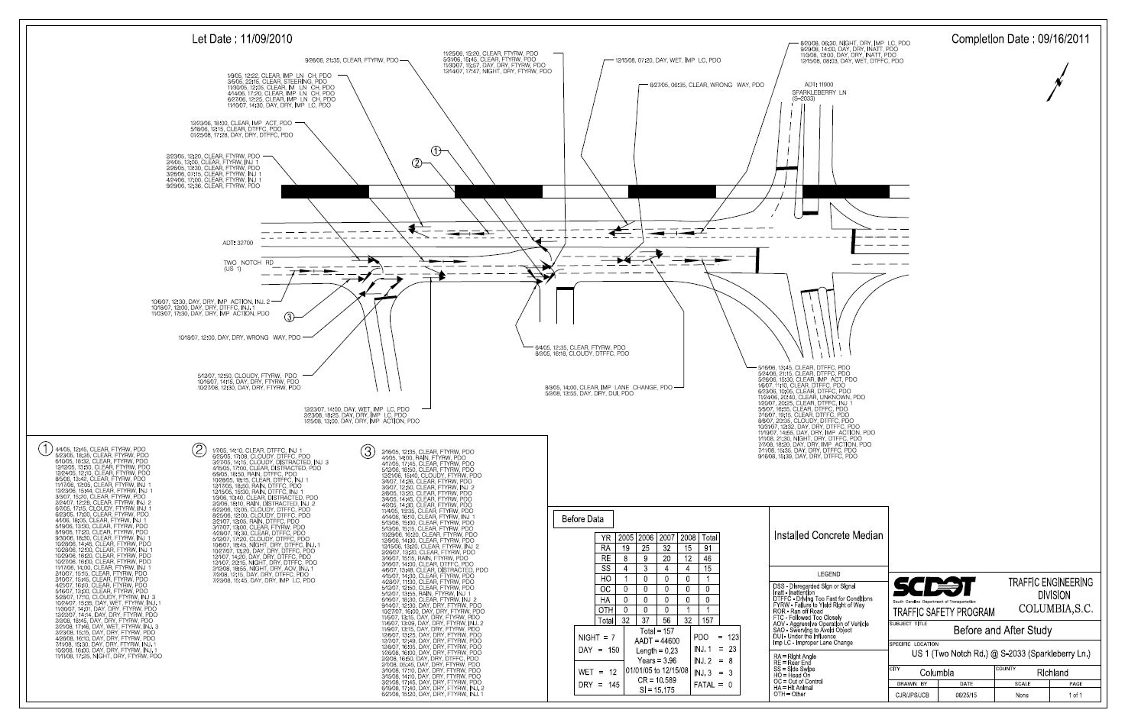
Example
Access Management Safety Project

Slide 38
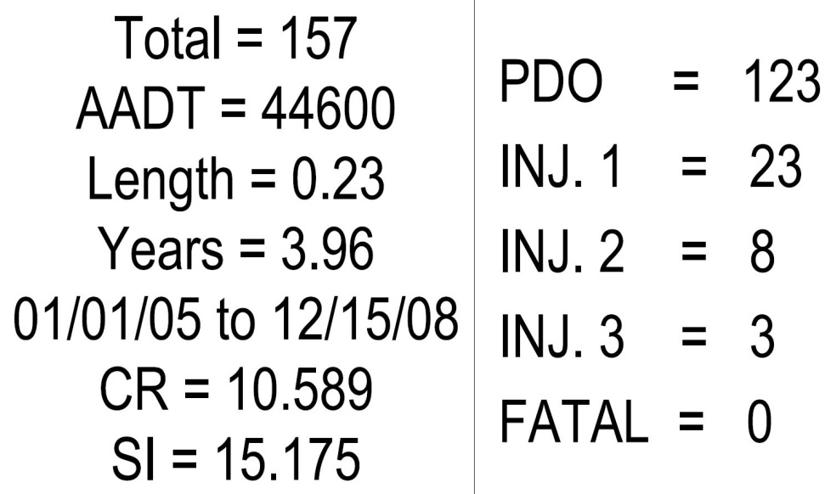
Richland County US 1

Slide 39
Project Evaluation
(approx. 3 years of data)
Before = 157
After = 86
Right Angle Crashes reduced from 91 to 7

Slide 40
Other Roadway Users Analysis

Slide 41
Vulnerable Roadway Users Analysis
These percentages represent all motorcycle, pedestrian moped & bicycle crashes. (i.e. motorcycle road departures / pedestrian intersection crashes)
Total Number of Fatal & SI Crashes: 1679
Crash Date Range: 2011-2015

Slide 42
Motorcycle Helmet Analysis
MPOs Statewide: 22% Helmet Used, 78% None
Total Number of Fatal & SI Crashes: 267
Crash Date Range: 2011-2015

Slide 43
Pedestrian Analysis
Total Number of Fatal & SI Crashes: 174
Crash Date Range: 2011-2015

Slide 44
Pedestrian Analysis
Motorist at Fault
Pedestrian at Fault
Total Number of Fatal & SI Crashes: 174
Crash Date Range: 2011-2015

